Slide 1
Laboratory Ergonomics​
Department of Environmental Health & Safety

Slide 2
Ergonomics
Ergonomics is the science and practice
of designing tasks and workplaces considering
our capabilities and limitations
or
fitting the work to the person -
User
Equipment/Workspace
Tasks

Slide 3
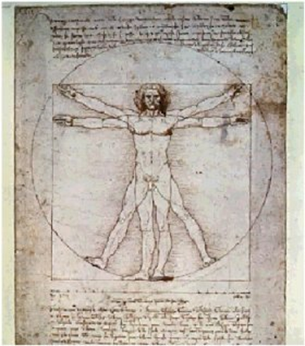
Benefits of Ergonomics
Prevention of work-related musculoskeletal disorders (WMSDs)
Reduced fatigue and discomfort
Increased productivity
Improved quality of work

Slide 4
What Are Work-Related Musculoskeletal Disorders?
WMSDs are soft-tissue injuries to muscles, tendons, ligaments, cartilage, blood vessels, and nerves that usually develop gradually.
They are also known as:
Cumulative Trauma Disorders (CTDs)
Repetitive Strain Injuries (RSIs)
Overuse Injuries

Slide 5
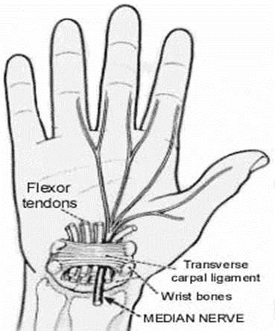
Common Work-Related Musculoskeletal Disorders
WMSDs occur in the moving body parts like the neck, back, shoulders, elbows, wrists, fingers and knees.
Low back injury
Carpal tunnel syndrome
Tendonitis
Tenosynovitis
Epicondylitis
De Quervain’s syndrome

Slide 6
Symptoms of Work-Related Musculoskeletal Disorders
Discomfort/pain
Swelling
Loss of range of motion
Stiffness or tight muscles
Hands or feet feel like they are falling “asleep”
Numbness/tingling
Burning sensations
Shooting/stabbing pains
Weakness or clumsiness in the hands; dropping things
Having one or more symptom does not mean you have a WMSD

Slide 7
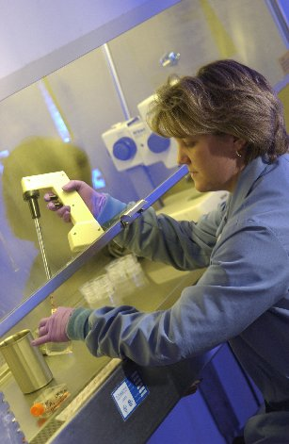
Causes of Work-Related Musculoskeletal Disorders
WMSDs can develop when demand exceeds capacity. Exposure (intensity, frequency, and duration) to the following risk factors or combination of risk factors might lead to a WMSD:
Awkward and static postures
Highly repetitive motions
High hand force
Contact stress
Vibration
Cold temperatures
Lighting

Slide 8
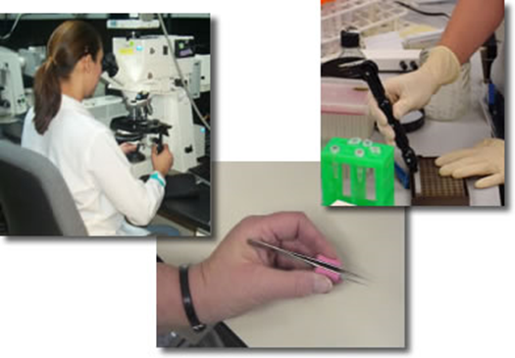
Prevention & Treatment of WMSDs
Preventing and responding to WMSDs involves:
Designing or modifying the work environment
Task variability
User health/fitness
Professional health care

Slide 9
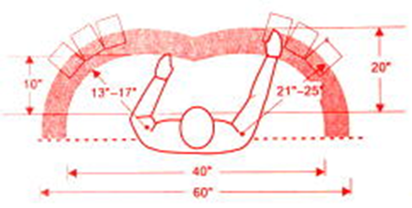
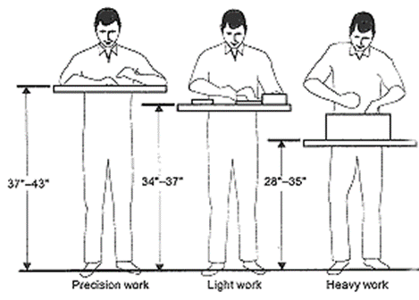
Laboratory Design
Good design minimizes awkward and static postures by allowing the user to:
Sit/stand in neutral postures
Frequently change postures
Locate equipment and materials based on use
Good design = desired postures & motions

Slide 10
Task Variability
Task variability offers several advantages:
Opportunity to change postures
Different tasks can use different muscle groups
Provides recovery time and pauses for stretches
Tasks with highly repetitive motions and high hand forces can be spread out throughout the workday
Users will be cognitively more alert and productive

Slide 11
Common laboratory activities
Pipetting
Microscopy
Microtome work
Fume hoods/biological safety cabinets
Micro-manipulation & fine motor skills
Standing work
Computer work
Lifting

Slide 12
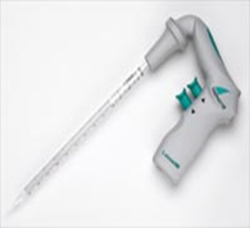
Pipetting
Associated risk factors:
Repetitive motions – hands, forearm, and thumb
Pinch grips – handling tips and vials
Bending and twisting of the wrist
“Winged” elbows
Neck bent forward or to the side and/or jutted chin
Excessive force of the thumb

Slide 13
Pipetting
Preventative measures:
Electronic or latch-mode pipette instead of manual plunger
Use thin-walled tips that are easy to eject
Limit periods of continuous pipetting to 20 minutes (2-minute micro breaks)
Adjust height/position of sample holders, containers, and waste receptacles to assure neutral postures
Ensure proper back and thigh support by using adjustable stools or chairs with foot and arm rests

Slide 14
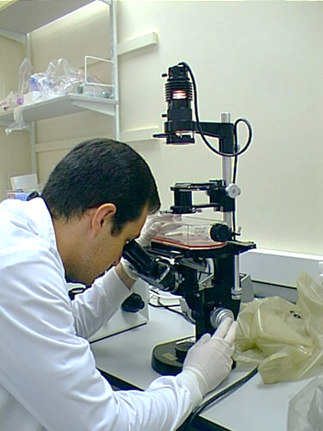
Microscopy
Associated risk factors:
Awkward and static posture of the neck and back
Lack of leg or knee clearance under worktable
Eye strain and fatigue
Wrist & arm contact stress
Pinch grip when making adjustments
“Winged” elbows

Slide 15
Microscopy
Preventative measures:
Extended eye tube and/or variable height adapter
Adjust eyepiece’s height to allow neutral posture of head and neck
Position microscope close to the user
Avoid arm and wrist contact pressure by padding sharp and hard edges
Ensure feet are flat on the floor or use a footrest
Reduce repetitive motion and prolonged awkward postures by taking micro breaks

Slide 16
Microscopy

Slide 17
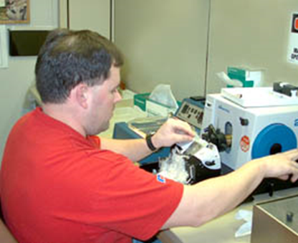
Microtome work
Associated risk factors:
Highly repetitive functions
Force of turning wheel
Awkward and static postures of the arms, back, and neck
Contact stress of the forearms and wrists

Slide 18
Microtome work
Preventative measures:
Place microtome at appropriate height based on user
Use chair/stool with adjustable arm and footrest
Protect wrist and forearms from contact stress by padding sharp and hard edges
Use less force when turning hand wheel
Take micro breaks
Replace manual rotary microtome with an automatic one

Slide 19
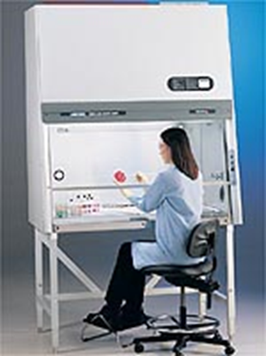
Fume hoods & biological safety cabinets
Associated risk factors:
Repetitive motions of the hands and wrists
Constrained knee and leg space in fume hoods and older biological safety cabinets
Awkward and static postures of the neck, torso, legs, arms, and wrists
Contact stress on the forearms, wrists, and knees and/or legs
Working with “winged” elbows
Eye strain

Slide 20
Fume hoods & biological safety cabinets
Preventative measures:
Position materials as close as possible to avoid extended reaching (at least 6” back for fume hood)
Avoid contact stress – apply foam padding
Reduce eyestrain and awkward postures by keeping viewing window of hood/biological safety cabinet and line of sight unobstructed
Make sure hood/biological safety cabinet lighting is working properly
Use an ergonomic task chair or stool with footrest
Take micro breaks

Slide 21
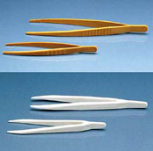
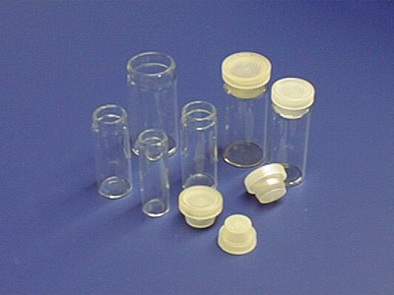
Micro-Manipulation & Fine Motor Skills
Associated risk factors:
Repetitive motion
Force
Awkward postures
Contact stress

Slide 22
Micro-Manipulation & Fine Motor Skills
Preventative measures:
Use plastic vials with fewer threads to reduce twisting motions during capping and uncapping lids
Use small pieces of foam where fingers and forceps articulate
Practice using forceps between first and second digits
Tilt storage bins towards workers
Take micro breaks

Slide 23
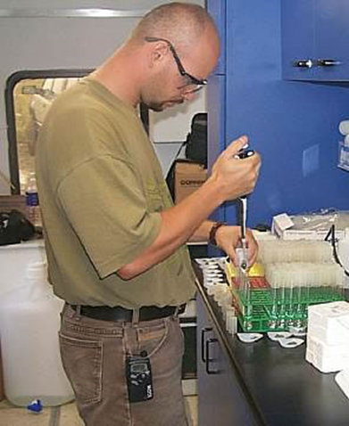
Standing Work
Associated risk factors:
Static postures
Awkward postures – neck, head, and arms
Associated health concerns:
Sore feet
Swelling of the legs
Fatigue
Low back pain
Neck pain

Slide 24
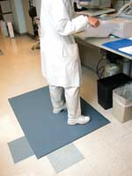
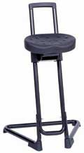
Standing Work
Preventative measures:
Proper shoes
Change in posture
Walking
Footrests
Sit/stand stools
Anti-fatigue mats

Slide 25
Computer work
Computer workstation ergonomic considerations:
User
Workstation configuration
Chair
Desk and keyboard/mouse tray
Input devices
Monitor – CRT vs. LCD
Tasks
Office lighting

Slide 26
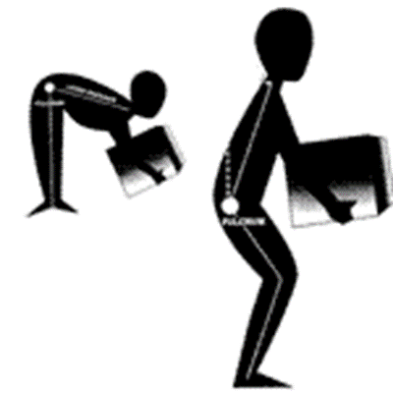
Lifting
Associated risk factors:
Health and injury history
Lifting, carrying, pulling, and pushing
Awkward and static postures
Object weight
Preventative measures:
Neutral postures
Fitness
Shorten lever arms
Minimize weight
Proper lifting technique

Slide 27
Questions & Consultation
If you have additional questions or would like to schedule an ergonomic evaluation, contact the Department of Environmental Health & Safety at spok.ehs@wsu.edu or 8-7621.

